Slide 1
Port of Port Townsend
Boatyard General Permit
Stormwater System

Slide 2
Permit Authority
Clean Water Act
National Pollutions Discharge Elimination System
Title 33 USC § 1251 et seq.
WA Water Pollution Control Act
RCW 90.48
Boatyard General Permit
Industrial Stormwater General Permit
WPPA Washington State Marine Terminal AKART and ISGP Corrective Action Guidance Manual
Boatyard General Permit issued
BGP reissued in 1997
BGP reissued again in 2005
2005 BFP was appealed
a court settlement included “pilot” testing of treatment technologies in 2007-8
An Economic Analysis – AKART (All Known Available and Reasonable Treatment) Study was initiated as part of this adoption, and completed in 2010
The permit has been subsequently reissued in 2011 and in 2016

Slide 3
Chronology
1996 stormwater installed
Designed by Reid Middleton
Conveyance
Sand Filters – perimeter & in-traffic
2010 system upgrade
Stormwater Rx units (2 of 4 main sub-basins)
Ecology funded $332k of $495k
2013 Notice of Intent
Waste Action Project

Slide 4
Chronology - continued
Settlement with WAP
2014 Level Three (3) response action
six (6) benchmark exceedances of zinc during the second quarter 2013
six (6) exceedances of copper in late 2013
August 2014 - Port had installed and implemented (Landau)
Escalating Level One (1) Source/Operational Controls
Level Three (3) Treatment Systems
Improvements to perimeter sand filters
Failed installation discovered
Reconfigure vaults & add oyster shells (biochar substituted)
Bench testing & pilot of biochar – downspout tote
Biochar coffyns installed

Slide 5
Chronology – continued
PPTBH continued to exceed the benchmarks for zinc and copper
Sampling point changed from Outfall A to 4 catch basins in 2016
Port & Ecology meeting in spring 2016
Administrative Order – issued June 17, 2016
Revised Engineering Report
The advanced treatment BMP shall be installed and implemented on or before September 30, 2017.

Slide 6
Engineering Report
Parametrix selected
Recommended Alternative
Bio-infiltration
Cost - $1.2 to $1.8 million
Area ~20,000 sq ft
Phased implementation
Segregated Basins

Slide 7
Phased implementation
2017 Construct Phase 1 Infiltration Basin
Connect Vault 1 Lift Station to Phase 1 Infiltration Basin
Relocate Boatyard Aquip Unit to Vault 2 and Replace Media with Biochar
Estimated Cost $400,000 ( Grant $200,000 – Port $200,000)
2018 Construct Return Flow Lift Station at Outfall A
Install Tide-Flex Valve on Outfall A
Run Force Main from Lift Station to Phase 1 Infiltration Basin
Estimated Cost $500,000 ( Grant $250,000 - Port $250,000)
2019 Construct Phase 2 Infiltration Basin (doubles capacity of Phase 1 infiltration)
Estimated Cost $400,000 (Grant $200,000 – Port $200,00)

Slide 8
Segregated Basins
Technical Memo (January 25, 2017)
Source BMPs
Removal of contaminated soils
Jetting of conveyance pipes
Cover of work areas
Conclusions
Reduce infiltration area by 20%
Twenty year life cycle costs

Slide 9
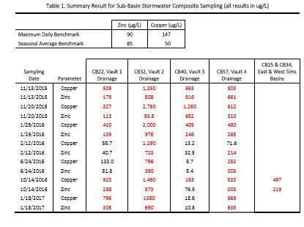

Slide 10
Modifications to Existing System

Slide 11
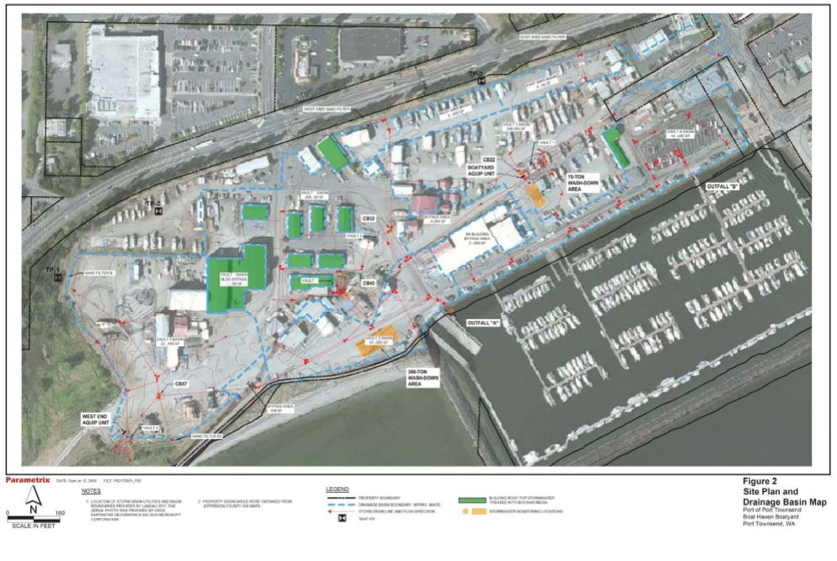

Slide 12
Infiltration vs System Modification
Infiltration
System Modification
May meet Ecology’s “Advance Treatment BMP” requirement
Order of magnitude higher initial cost
Significant impact to operational land area
Need to settle issue of treatment quantity
Meets AKART adaptive management
Order of magnitude lower initial cost
Little if any impact to operational land area
Can be paired with long term facility planning
Potentially can be paired with Integrated Planning Grant

Slide 13
Crossover from Industrial Stormwater General Permit
Permittees must fully implement the stormwater treatment approach included in their Ecology-approved Engineering Report as soon as possible, but not later than September 30th of the year following year following the calendar year during which the Level 3 Corrective Actions were triggered, unless an alternate date is specified in an order.
Permittees may engage Ecology to determine whether the treatment facility installed under the previous Level 3 can be upgraded to more effectively treat stormwater. Stormwater treatment system upgrades are anticipated to include modification of the existing treatment system, including additional upgrades and/or potential structural additions. In some cases, the existing treatment system may be augmented by a pretreatment or polishing step (i.e., expanded treatment train). The Permittee’s plans for treatment system upgrades must to be submitted to Ecology for review and approval in an engineering report.

Slide 15
2016 Boatyard General Permit
Requirements for Level 3 Response
Engineering report within 60 days of 6th exceedance
Implementation within 12 months of Ecology’s acceptance of Engineering report
Ecology recognizes that the BGP is silent on requirements for when a Level 3 response does not meet benchmarks

Slide 16
Recommendation
Request modification to Administrative Order
Timeline to submit a revised engineering report
Timeline for 12 months to install approved engineering report
Approve staff to seek a proviso for an Integrated Planning Grant

