Slide 1
Point Hudson Breakwater Improvement Project
Port Commission Meeting
June 2020

Slide 2
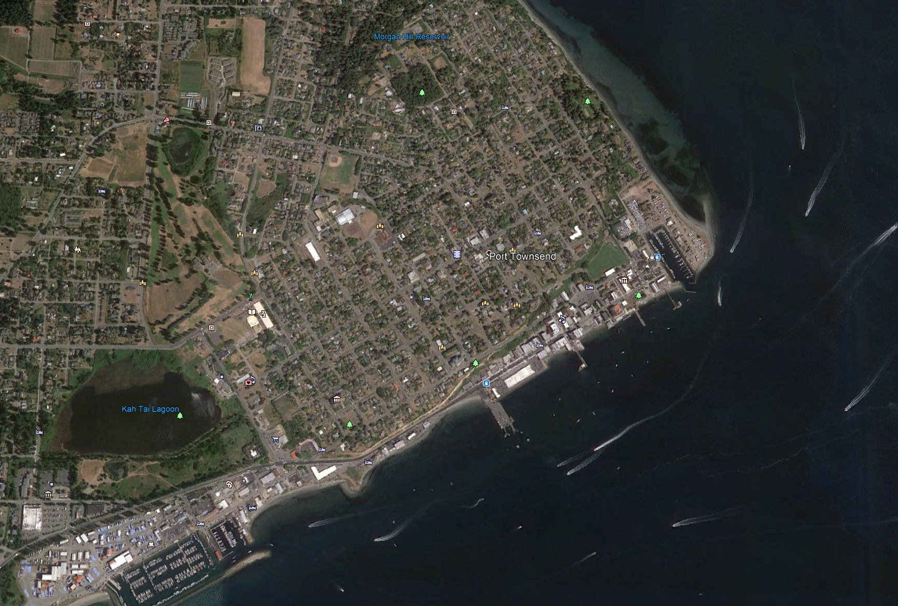
Introduction
Background
Port Townsend
NORTH JETTY
Point Hudson
SOUTH JETTY
Breakwaters

Slide 3
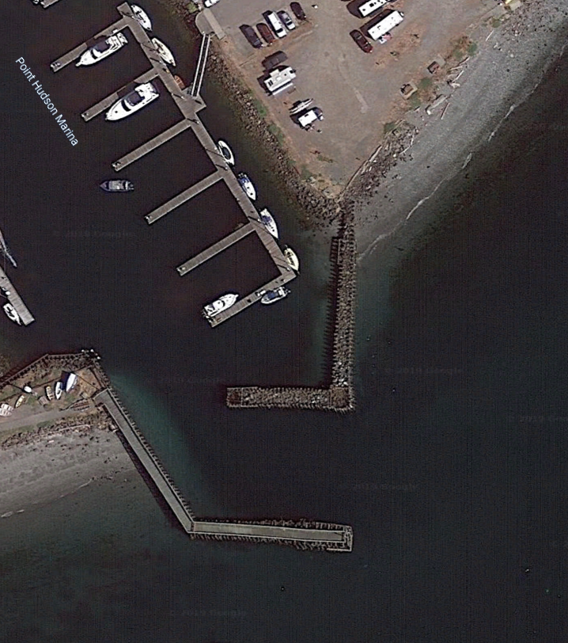
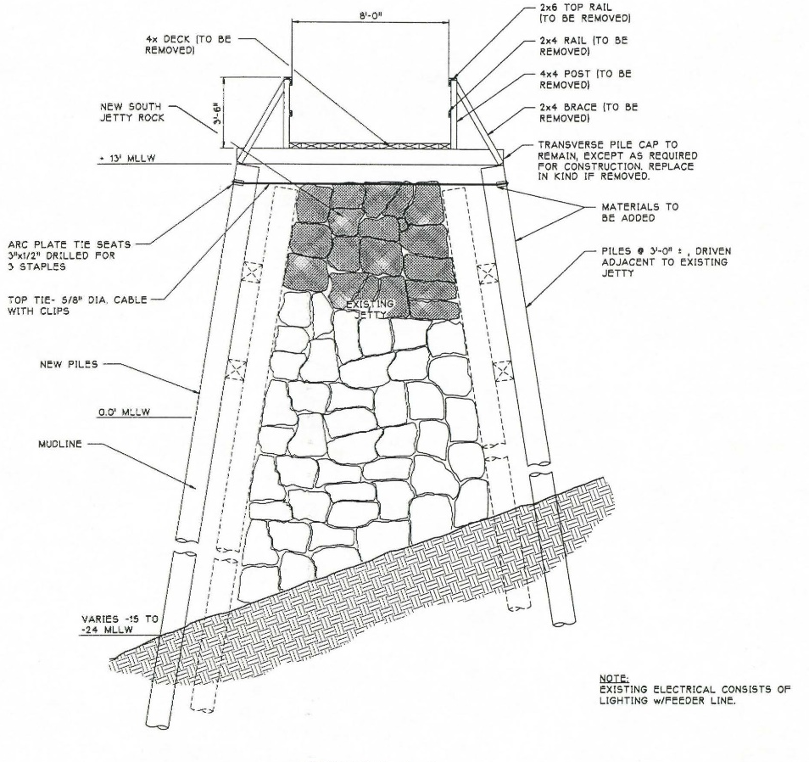
Introduction
1934 Original Construction
Site Overview
The breakwaters were constructed in 1934 by the military.
Major rehabilitation was performed in 1969, with additional retrofit of the breakwater ends performed in 1996.
1969 Rehabilitation
Beach Erosion
Marina Basin
1996 Partial Rehabilitation
Shoal
Narrow Entrance
Typ. Vessel Approach
Shoal
Sediment Drift
Waves from ESE
Waves from S

Slide 4
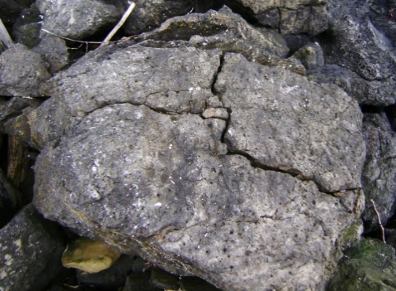
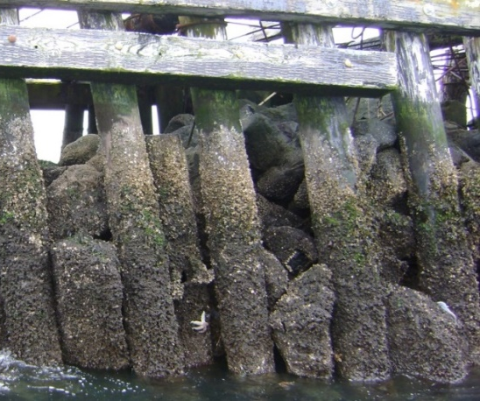
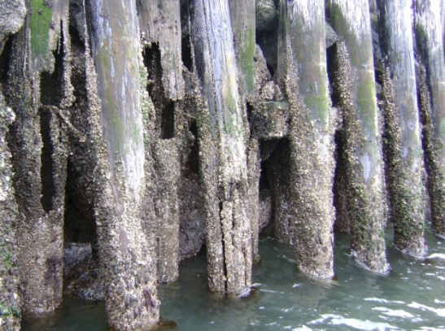
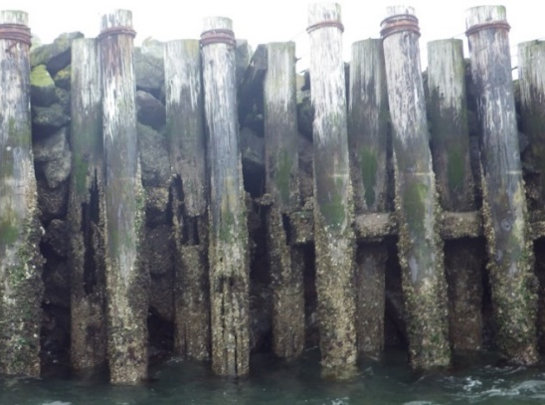
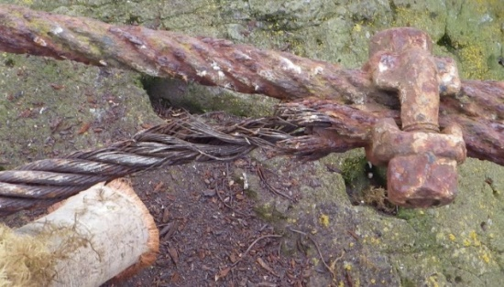
Introduction
Existing Condition
Timber piles, walers, cable tiebacks, and armor rock are at or beyond useful life. Stability of the overall structural system is compromised.
The most advanced structural deterioration was observed at the end of the south breakwater.
Voids in the riprap reduce the system’s wave protection capability.
Stone Deterioration
Structure Failure
Pile Deterioration
Waler Deterioration
Cable Deterioration

Slide 5
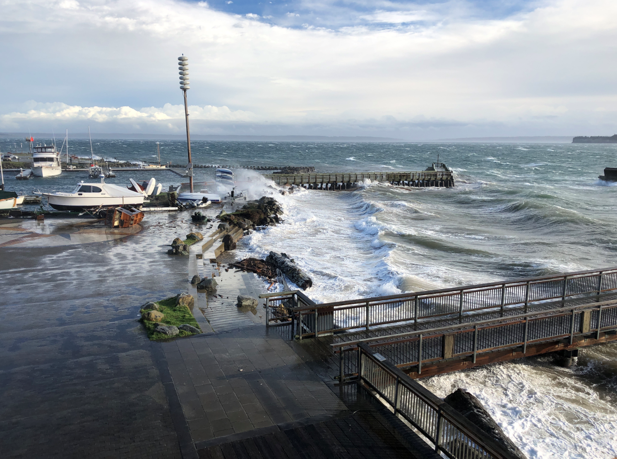
A Challenging Marine Environment
A 2018 storm damaged the breakwaters, breaking pile tops, severing cable ties and further eroding the armor rock core.
Constructing the Replacement Breakwater is the first step in building resilience for Point Hudson’s future.
Photo taken by Ron Moller
A December 2018 storm sweeps over the jetties and into the Point Hudson Marina.

Slide 6
Design Objectives
Overview
The guiding objectives are to provide a breakwater rehabilitation/replacement design that:
Provides wave protection for the Point Hudson Marina for a minimum design life of 30 years.
Responds to community concerns to maintain the aesthetic of the existing breakwater.
Can be permitted, constructed and maintained.

Slide 7
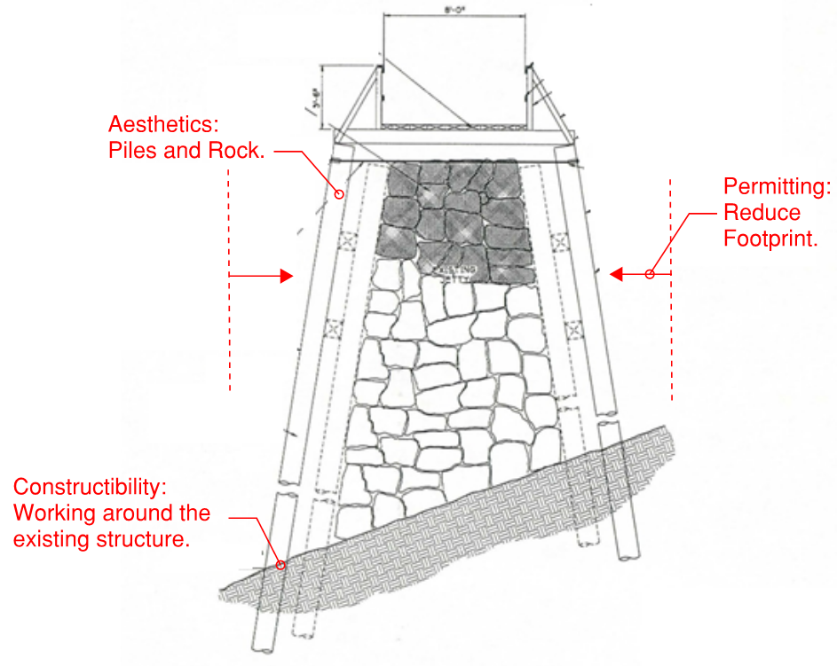
Design Objectives
Replacement breakwater height must include sea level rise resistance
Engineering. Protect existing marina and Port operations for 30 years from wind and vessel waves and sea level rise.
Aesthetics. Similar in appearance to existing breakwater (rocks and piles) using environmentally acceptable materials.
Environmental Considerations. Remove creosote, reduce breakwater footprint, and protect existing eelgrass outside of marina.
Constructability. Minimize risks from potential cost overruns, delays, errors, and obstacles during construction.
Cost. Efficient design that minimizes maintenance costs.
Environmental Considerations: Reduce Footprint
Environmental Considerations: Remove rock and debris within 10 ft of the base

Slide 8
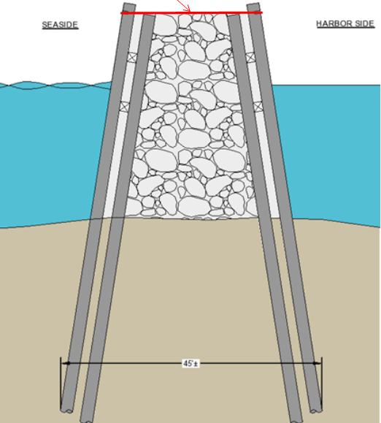
Alt. Evaluation: Encapsulation vs. Replacement
~10’
~2.5’
Existing structure remains except for a few select creosote timber piles removed for permitting.
Piles driven in a batter outside of existing structure, expand footprint by 2.5 ft each side with mesh lagging.
Reduces demo costs but increases offsite mitigation costs.
Existing structure is completely removed including piles and rock.
Piles driven batter with new rock installed between the rows of piling.
Seeks to be self mitigating because of the reduction in footprint and creosote removal.

Slide 9
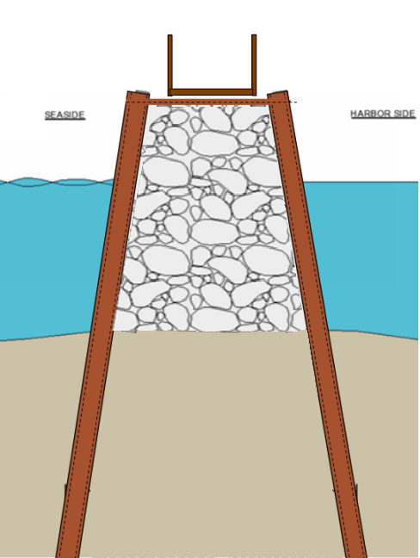
Breakwater Design
Stakeholder Input
After review of the different alternatives, stakeholders selected replacement as their preferred alternative with some additional input.
In addition to selecting replacement as the preferred design, the stakeholders presented the following suggestions and guidance:
Category | Input
Pile | Piles should be closely spaced, similar to the existing Piles should be uncoated steel pipe piles with sacrificial corrosion thickness, no composite piles Piles should be battered to match existing aesthetics Piles should be supported with tie rod cross-ties and potential walers
Breakwater Core | Large high quality riprap (granite) No mesh for rock containment
Walkway | Design and system should allow for installation of walkway on top of the south breakwater End of walkway waterside should incorporate a wider turnaround and look out area
Permitting | North and south breakwaters should be designed and permitted together

Slide 10
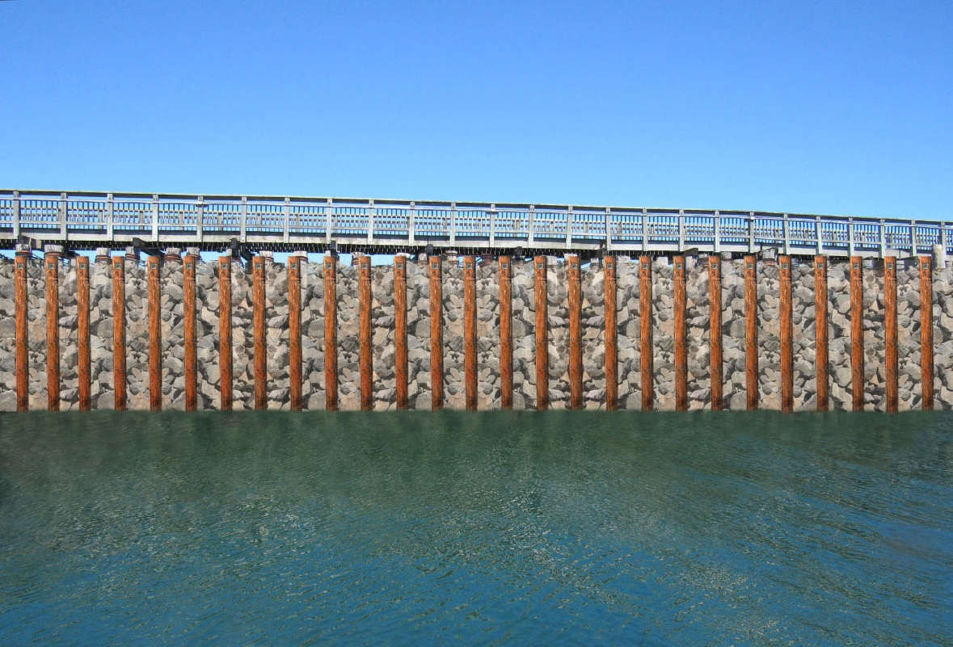
Selected Breakwater Design - Replacement
Selected Cross-Section and Elevation
New 8’ Wide Walkway
Tiebacks & Walers on Top of Piles
New Walkway
A
Piles spaced 3 ft- on center, TBD in final design
New Large Armor Stone
A
New Battered, Uncoated Steel Pipe Pile
New Battered, Uncoated Steel Pipe Piles
Section A - A
Elevation View

Slide 11
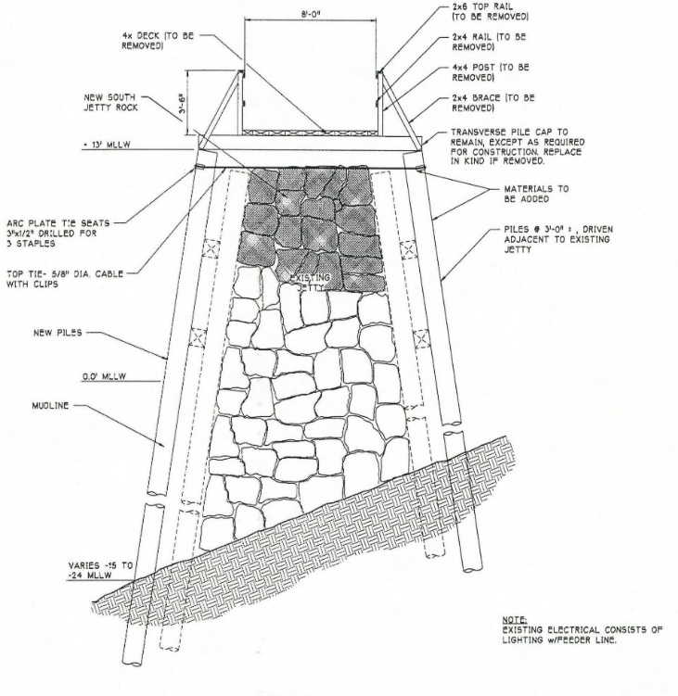
Environmental Goals and Benefits
ENVIRONMENTAL PERMIT GOALS:
1. AVOID RE-INITIATING CONSULTATION WITH NMFS
2. DESIGN A SELF-MITIGATING STRUCTURE
1934 Original Construction
1969 Rehabilitation
ENVIRONMENTAL BENEFITS:
1. CREOSOTE REMOVAL 827 piles (~ 250 tons) + walers
2. SMALLER FOOTPRINT (~12 %)
3. ROCK AND DEBRIS REMOVAL within 10 ft of jetties

Slide 12
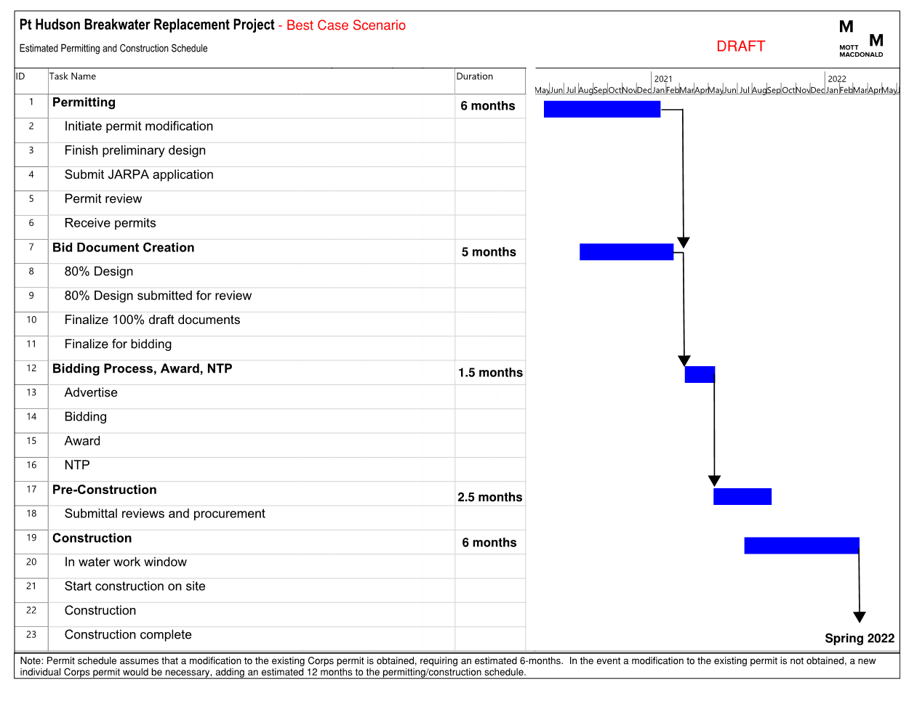
Project Schedule
Scenario 1 – Best Case (Goal)
Construction Completion Spring of 2022

Slide 13
Other Potential Permitting Scenarios/Schedules
 | Scenario 1 (Best Case) | Scenario 2 | Scenario 3
Description | Existing permit is modified for current design | Existing permit is modified but NMFS is re-engaged | Modification is rejected and a new permit application is required.
Permitting Length | 6 months | 12 months | 18 + months
Permit Submittal | July 2020 | July 2020 | July 2020
Permit Received | Jan 2021 | July 2021 (+6 months) | Jan 2022 (+12 months)
Bid Advertisement | Spring 2021 | Spring 2021 | Spring 2022 (+12 months)
Construction Start | Fall 2021 | Fall 2021 | Fall 2022 (+1 year)
Construction End* | Spring/Fall 2022 | Spring/Fall 2022 | Spring/Fall 2023 (+1 year)
*Would seek to replace breakwater in one construction season however, depending on fish work window requirements, replacement may need to occur over two in water work windows.

Slide 14
Summary
Replacement Alternative
Breakwater replacement alternative similar in style as existing breakwater with modern materials and walkway on south breakwater.
Permitting
Permitting will include replacement of both breakwaters.
Final Design
Final design will be for replacement of both breakwaters.
Project Bidding for Construction
Bid Documents developed for replacement of south breakwater first.
Schedule
Earliest completion of the south breakwater replacement is spring or fall of 2022.

Slide 15
Project Costs
Total Project Costs (South and North)
Construction Cost - $12.5 Million (2020 dollars)
Engineering, Permitting, Bid Docs - $394,000
Construction Administration (South) - $250,000
Construction Administration (North) - $250,000
Grand Total = $13.39 Million (2020 dollars)
Total Project Costs (South Replacement Only)
Construction Cost - $7 Million (2020 dollars)
Engineering, Permitting, Bid Docs - $373,000
Construction Administration (South) - $250,000
Grand Total = $7.62 Million (2020 dollars)
Variables
Costs assume two separate construction seasons which is most likely scenario due to funding and potential fish window restrictions
Permitting from scratch (Scenario 3) would increase permitting costs
Costs include the new walkway on the south breakwater
Does not include cost inflation
Cost does not include offsite mitigation costs that could be required (0%-5% of project costs)
Cost does not include potential repairs needed to the existing breakwaters while waiting for replacement

Slide 16
Next Steps
Submit Permits
Complete Final Design

Slide 17
Questions?

